Slide 1
PROJECT-SQL
IPL AUCTION

Slide 2
NAME-GAURAV SITLANI
COURSE- PGC (Data Science)
BATCH – 1ST JUNE
Topic – SQL USING POSTGRES SQL(IPL AUCTION)

Slide 3
ACKNOWLEDGEMENT
I would like to express my sincere gratitude and appreciation to the entire team at Internshala for providing me with the opportunity to learn PostgreSQL. Special thanks to my course coordinator for their valuable insights and continuous encouragement. I am also grateful to the technical support team for their prompt assistance. The development and maintenance team deserves thanks for creating well-structured modules. Lastly, I want to thank my family and friends for their unwavering support. Thank you all for your dedication and guidance.

Slide 4
Objective
To create a list of players to assist the IPL team owners
1.Aggressive batter
2.Anchor batter
3. Finishers
4. Big-hitters
5. Rotators of strike
6.all rounder
7.wicket keeper

Slide 5
QUERIES FOR USING IN TABLES
--table 1
drop table matches;
CREATE TABLE matches (
match_id int,
city varchar,
date date,
player_of_match varchar,
venue varchar,
neutral_venue int,
team1 varchar,
team2 varchar,
toss_winner varchar,
toss_decision varchar,
winner varchar,
result_mode varchar,
result_margin int,
eliminatir varchar,
method_dl varchar,
umpire1 varchar,
umpire2 varchar
);

Slide 6
--table 2
drop table balls;
CREATE TABLE balls(
match_id int,
inning int,
over int,
ball int,
batsman varchar,
non_striker varchar,
bowler varchar,
batsman_runs int,
extra_runs int,
total_runs int,
is_wicket int,
dismissal_kind varchar,
player_dismessed varchar,
fielder varchar,
extras_type varchar,
batting_team varchar,
bowling_team varchar
);
--copy data
copy matches from'C:\Program Files\PostgreSQL\10\data\IPL Dataset\IPL_matches.csv' CSV header;
copy balls from'C:\Program Files\PostgreSQL\10\data\IPL Dataset\IPL_Ball.csv' CSV header;
select * from matches
select * from balls

Slide 7
Task1
Your first priority is to get 2-3 players with high S.R who have faced at least 500 balls.
And to do that you have to make a list of 10 players you want to bid in the auction so that when
you try to grab them in auction you should not pay the amount greater than you have in the purse
for a particular player.*/
-- Create Aggressive_batsman table
CREATE TABLE Aggressive_batsman AS
SELECT batsman,
SUM(batsman_runs) AS run_count,
COUNT(ball) AS tot_balls_faced,
COUNT(ball) FILTER (WHERE batsman_runs = 0 AND extra_runs > 0) AS wides
FROM balls
GROUP BY batsman
ORDER BY run_count DESC;
-- Retrieve top 10 aggressive batsmen with minimum 500 legal deliveries
SELECT batsman,
run_count,
tot_balls_faced - wides AS legal_balls,
(run_count / CAST(tot_balls_faced - wides AS float)) * 100 AS strike_rate
FROM Aggressive_batsman
WHERE tot_balls_faced > 500
ORDER BY strike_rate DESC
LIMIT 10;

Slide 8
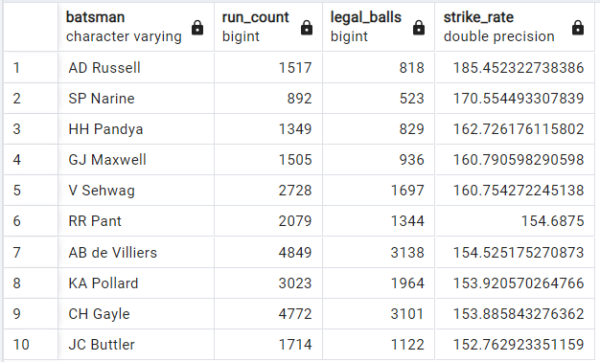
OUTPUT

Slide 9
--Task2
/*Now you need to get 2-3 players with good Average who have played more the 2 ipl seasons.And to do that you have to make a list of 10 players you want to in the auction so that when you try to grab them in auction you should not pay the amount greater than you have in the purse for a particular player.*/
CREATE TABLE "master" AS
SELECT *
FROM "balls"
INNER JOIN "matches" USING (match_id);
CREATE TABLE "anchor_batsman" AS
SELECT batsman,
SUM(batsman_runs) AS "run_count",
SUM(is_wicket) AS "Dismissals",
(SUM(batsman_runs) / NULLIF(SUM(is_wicket), 0)) AS average,
COUNT(DISTINCT EXTRACT(YEAR FROM date)) AS seasons
FROM "master"
GROUP BY batsman
HAVING COUNT(DISTINCT EXTRACT(YEAR FROM date)) > 2
ORDER BY average DESC;
SELECT *
FROM "anchor_batsman"
ORDER BY average DESC
LIMIT 10;

Slide 10
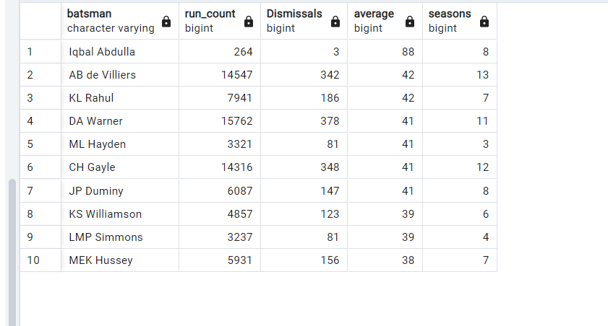
OUTPUT

Slide 11
--Task 3
/*Now you need to get 2-3 Hard-hitting players who have scored most runs in boundaries and have played more the 2 ipl season. To do that you have to make a list of 10 players you want to bid in the auction so that when you try to grab them in auction you should not pay the amount greater than you have in the purse for a particular player.*/
--Hardhitters
--STEP 1
CREATE TABLE "sixfours" as (SELECT batsman,
COUNT(CASE WHEN batsman_runs >= 6 THEN 1 END) AS six_count,
COUNT(CASE WHEN batsman_runs = 4 THEN 1 END) AS four_count,
SUM(batsman_runs) as Totalruns,count ( distinct extract (year from date)) as seasons
FROM master
GROUP BY batsman
ORDER BY totalruns desc);
--step 2
CREATE TABLE "boundaries" as (SELECT batsman, COUNT(*) AS boundaries
FROM master
WHERE batsman_runs >= 4
GROUP BY batsman
ORDER BY boundaries desc);

Slide 12
--step 3
CREATE TABLE "hardhitter" as (SELECT a.*,b.boundaries
FROM sixfours AS a
INNER JOIN boundaries AS b
ON a.batsman = b.batsman
group by a.batsman,a.six_count,a.four_count,a.Totalruns,b.boundaries,a.seasons
order by Totalruns desc);
select * from "hardhitter";
SELECT *, CAST(((six_count * 6) + (four_count * 4)) AS DECIMAL)*100 / totalruns AS bound_perc
FROM "hardhitter" where seasons >2
order by bound_perc desc limit 10;

Slide 13
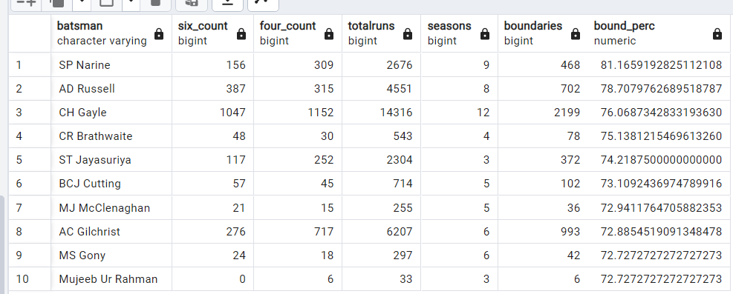
OUTPUT

Slide 14
--task 4
/*Your first priority is to get 2-3 bowlers with good economy who have bowled at least 500 balls in IPL so far.To do that you have to make a list of 10 players you want to bid in the auction so that when you try to grab them in auction you should not pay the amount greater than you have in the purse for a particular player.*/
--STEP 1--
select
bowler, ballcount,runs_conceded,
(runs_conceded / (floor(ballcount / 6) + (ballcount % 6) / 10)) as economy_rate,
floor(ballcount / 6) + (ballcount % 6) / 10 as overs_bowled
from
(select bowler, count(ball) as ballcount, sum(total_runs) as runs_conceded
from "balls"
group by bowler
having count(ball) >= 500)
as subquery
order by economy_rate asc limit 10;

Slide 15
--step 2
create table "ECONOMY BOWLER LIST" as
(select
bowler, ballcount,runs_conceded,
(runs_conceded / (floor(ballcount / 6) + (ballcount % 6) / 10)) as economy_rate,
floor(ballcount / 6) + (ballcount % 6) / 10 as overs_bowled
from
(select bowler, count(ball) as ballcount, sum(total_runs) as runs_conceded
from "balls"
group by bowler
having count(ball) >= 500)
as subquery
order by economy_rate asc limit 10);
--step 3
select * from "ECONOMY BOWLER LIST";

Slide 16
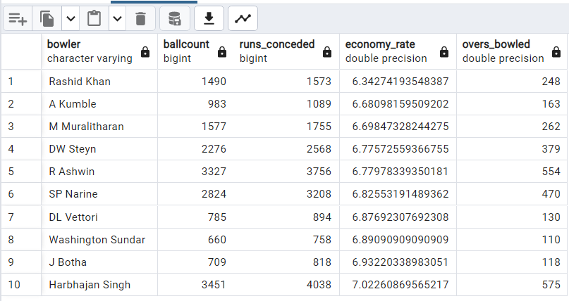
OUTPUT

Slide 17
--task 5
/*Now you need to get 2-3 bowlers with the best strike rate and who have bowled at least 500 balls in IPL so far.To do that you have to make a list of 10 players you want to bid in the auction so that when you try to grab them in auction you should not pay the amount greater than you have in the purse for a particular player.
select bowler,
sum(is_wicket)as total_wickets,
(count(ball)/NULLIF(sum(is_wicket),0))*1.0 as strike_rate
from balls
group by bowler
order by strike_rate*/
select bowler,count(bowler) as balls,
sum(is_wicket) as total_wicket,
((count(bowler)/sum(is_wicket)))as strike_rate
from balls
group by bowler
having count(bowler)>500
order by strike_rate asc
limit 10;

Slide 18
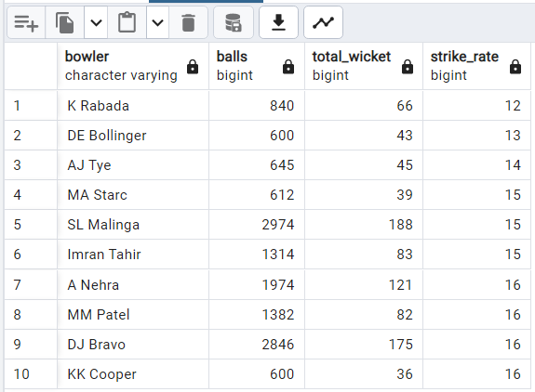
OUTPUT

Slide 19
--task 6
/*Now you need to get 2-3 All_rounders with the best batting as well as bowling strike rate and who have faced at least 500 balls in IPL so far and have bowled minimum 300 balls.To do that you have to make a list of 10 players you want to bid in the auction so that when you try to grab them in auction you should not pay the amount greater than you have in the purse for a particular player.*/
--wicket taking bowler
create table strike_bowler as (select bowler,
sum(case when dismissal_kind = 'lbw' then 1 else 0 end) as lbw_wickets,
sum(case when dismissal_kind = 'caught' then 1 else 0 end) as caught_wickets,
sum(case when dismissal_kind = 'bowled' then 1 else 0 end) as bowled_wickets,
sum(case when dismissal_kind = 'stumped' then 1 else 0 end) as stumped_wickets,
sum(case when dismissal_kind = 'hit wicket' then 1 else 0 end) as hit_wicket,
sum(case when dismissal_kind = 'caught and bowled' then 1 else 0 end) as caught_and_bowled,
count(ball) as ball_count
from master
group by bowler
order by caught_wickets desc, bowled_wickets desc);
create table strikebowler as (select *,Round(cast(ball_count as decimal(10,2))/ cast(Total_wickets as decimal(5,2)),2) as strike_rate
from
(select *, (lbw_wickets+caught_wickets+bowled_wickets+stumped_wickets+hit_wicket+caught_and_bowled) as Total_wickets
from
strike_bowler
group by bowler,lbw_wickets,caught_wickets,bowled_wickets,stumped_wickets,ball_count,hit_wicket,caught_and_bowled
having ball_count >500
order by Total_wickets desc) as subquery
order by strike_rate asc
limit 10);

Slide 20
CREATE TABLE "bowling_allrounder" AS
SELECT bowler,
total_wickets,
ROUND(CAST(ball_count AS DECIMAL(10, 2)) / CAST(Total_wickets AS DECIMAL(5, 2)), 2) AS strike_rate
FROM (
SELECT *,
(lbw_wickets + caught_wickets + bowled_wickets + stumped_wickets + hit_wicket + caught_and_bowled) AS Total_wickets
FROM strike_bowler
GROUP BY bowler, lbw_wickets, caught_wickets, bowled_wickets, stumped_wickets, ball_count, hit_wicket, caught_and_bowled
HAVING ball_count > 300
ORDER BY Total_wickets DESC
) AS subquery
ORDER BY strike_rate ASC;
CREATE TABLE "bat_all_roudr" AS
SELECT batsman AS "bat",
SUM(batsman_runs) AS "run_count",
COUNT(ball) AS "balls_faced",
SUM(is_wicket) AS "Total Dismissals",
CAST(SUM(batsman_runs) AS FLOAT) / CAST(COUNT(ball) AS FLOAT) * 100 AS "strike_rate"
FROM "balls"
GROUP BY batsman
HAVING COUNT(ball) > 500
ORDER BY run_count DESC;

Slide 21
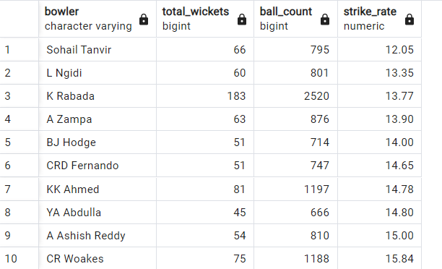
CREATE TABLE "BAT_ALL_ROUNDER_list" AS
SELECT bat_all_roudr.batsman AS all_rounder,
bat_all_roudr.run_count AS runs,
bat_all_roudr.strike_rate AS bat_SR,
bowling_allrounder.Total_wickets,
bowling_allrounder.strike_rate AS bow_SR
FROM bat_all_roudr, bowling_allrounder
WHERE bat_all_roudr.batsman = bowling_allrounder.bowler
GROUP BY bat_all_roudr.batsman, bat_all_roudr.run_count, bat_all_roudr.strike_rate, bowling_allrounder.Total_wickets, bowling_allrounder.strike_rate
ORDER BY bat_all_roudr.strike_rate DESC, bowling_allrounder.strike_rate ASC
LIMIT 10;
SELECT * FROM "BAT_ALL_ROUNDER_list";

Slide 22
--wicket keeper
create table wicket_keepers as (select fielder as wicket_keeper,
count(dismissal_kind) as stumpings
from master where is_wicket>0 and dismissal_kind = 'stumped'
group by wicket_keeper
order by stumpings desc);
create table wicket_keeper_fielding as (select a.*,b.catches
from wicket_keepers as a
inner join (select fielder,
count(case when dismissal_kind = 'caught' Then 1 else 0 End) as catches
from master
group by fielder
order by catches desc) as b
on a.wicket_keeper = b.fielder
group by a.wicket_keeper,a.stumpings,b.fielder,b.catches
order by a.stumpings desc);

Slide 23
select a.*,b.six_count,b.four_count,b.Totalruns,b.seasons
from wicket_keeper_fielding as a
inner join
(SELECT a.*,b.boundaries
FROM sixfours AS a
INNER JOIN boundaries AS b
ON a.batsman = b.batsman
group by a.batsman,a.six_count,a.four_count,a.Totalruns,b.boundaries,a.seasons
order by Totalruns desc) as b
on a.wicket_keeper = b.batsman
group by a.wicket_keeper,a.stumpings,a.catches,b.totalruns,b.six_count,b.four_count,b.seasons
order by b.totalruns desc,a.catches desc,a.stumpings desc,b.six_count,b.four_count;
create table best_WK_list as (select a.*,b.six_count,b.four_count,b.Totalruns,b.seasons
from wicket_keeper_fielding as a
inner join
(SELECT a.*,b.boundaries
FROM sixfours AS a
INNER JOIN boundaries AS b
ON a.batsman = b.batsman
group by a.batsman,a.six_count,a.four_count,a.Totalruns,b.boundaries,a.seasons
order by Totalruns desc) as b
on a.wicket_keeper = b.batsman
group by a.wicket_keeper,a.stumpings,a.catches,b.totalruns,b.six_count,b.four_count,b.seasons
order by b.totalruns desc,a.catches desc,a.stumpings desc,b.six_count,b.four_count limit 10);
select * from best_WK_list;

Slide 24
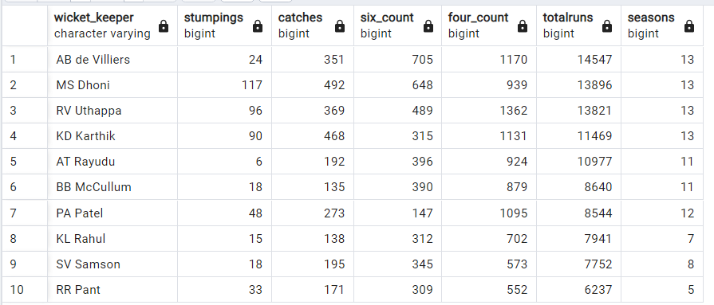
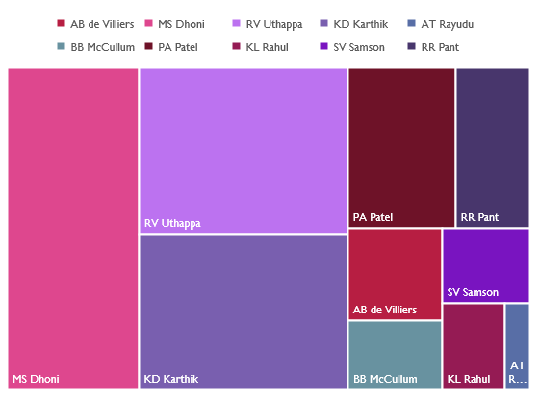
OUTPUT

Slide 25
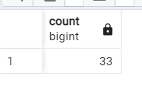
ADDITIONAL QUESTION
1.Get the count of cities that have hosted an IPL match
select count (distinct city) from "matches";
OUTPUT
/*2.Create table deliveries_v02 with all the columns of the table ‘deliveries’ and an additional column ball_result containing values boundary, dot or other
depending on the total_run (boundary for >= 4, dot for 0 and other for any other number)(Hint 1 : CASE WHEN statement is used to get condition based results)
(Hint 2: To convert the output data of the select statement into a table, can use a subquery. Create table table_name as [entire select statement].*/
CREATE TABLE deliveries_v02 AS
SELECT
*,
CASE
WHEN total_runs >= 4 THEN 'boundary'
WHEN total_runs = 0 THEN 'dot'
ELSE 'other'
END AS ball_result
FROM
deliveries;

Slide 26
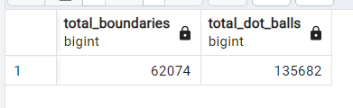
/*3.Write a query to fetch the total number of boundaries and dot balls from the deliveries_v02 table.*/
SELECT
SUM(CASE WHEN total_runs = 4 OR total_runs = 6 THEN 1 ELSE 0 END) AS total_boundaries,
SUM(CASE WHEN total_runs = 0 THEN 1 ELSE 0 END) AS total_dot_balls
FROM
deliveries_v02;
OUTPUT

Slide 27
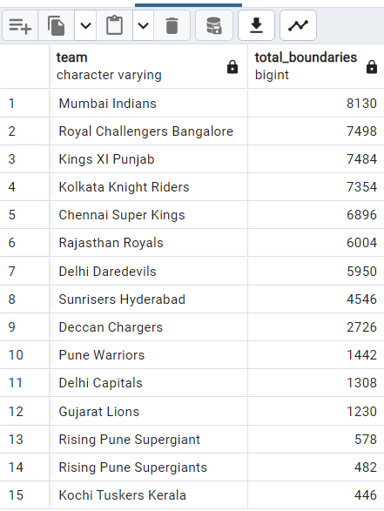
/*4.Write a query to fetch the total number of boundaries scored by each team from the deliveries_v02 table and order it in descending order of the number of boundaries scored.*/
SELECT
batting_team AS team,
SUM(CASE WHEN total_runs = 4 OR total_runs = 6 THEN 1 ELSE 0 END) AS total_boundaries
FROM
deliveries_v02
GROUP BY
batting_team
ORDER BY
total_boundaries DESC;
OUTPUT

Slide 28
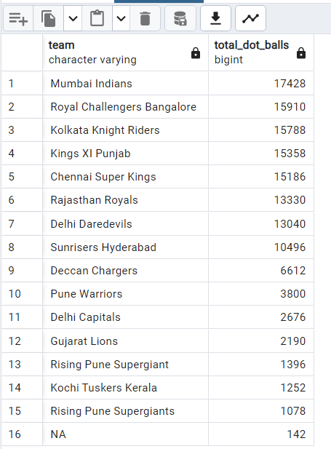
/*5.Write a query to fetch the total number of dot balls bowled by each team and order it in descending order of the total number of dot balls bowled.*/
SELECT
bowling_team AS team,
SUM(CASE WHEN total_runs = 0 THEN 1 ELSE 0 END) AS total_dot_balls
FROM
deliveries_v02
GROUP BY
bowling_team
ORDER BY
total_dot_balls DESC;
OUTPUT

Slide 29
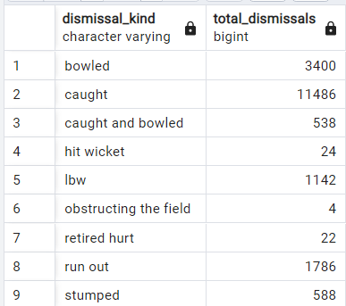
6.Write a query to fetch the total number of dismissals by dismissal kinds where dismissal kind is not NA /
SELECT
dismissal_kind,
COUNT(*) AS total_dismissals
FROM
deliveries_v02
WHERE
dismissal_kind <> 'NA'
GROUP BY
dismissal_kind;
OUTPUT

Slide 30
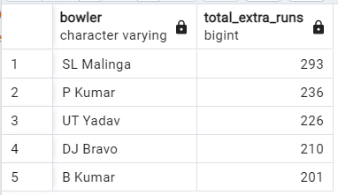
7. Write a query to get the top 5 bowlers who conceded maximum extra runs from the deliveries table
SELECT
bowler,
SUM(extra_runs) AS total_extra_runs
FROM
deliveries
GROUP BY
bowler
ORDER BY
total_extra_runs DESC
LIMIT 5;
OUTPUT

Slide 31
8.Write a query to create a table named deliveries_v03 with all the columns of deliveries_v02 table and two additional column (named venue and match_date)of venue and date from table matches
CREATE TABLE deliveries_v03 AS
SELECT
dv.*,
m.venue,
m.date AS match_date
FROM
deliveries_v02 AS dv
JOIN
matches AS m ON dv.match_id = m.match_id;

Slide 32
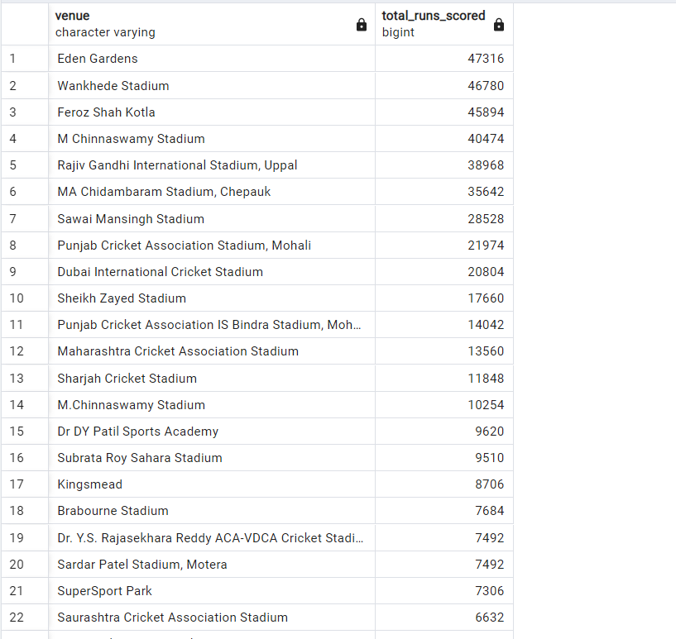
/*9 Write a query to fetch the total runs scored for each venue and order it in the descending order of total runs scored. */
SELECT
venue,
SUM(total_runs) AS total_runs_scored
FROM
deliveries_v03
GROUP BY
venue
ORDER BY
total_runs_scored DESC;
OUTPUT

Slide 33
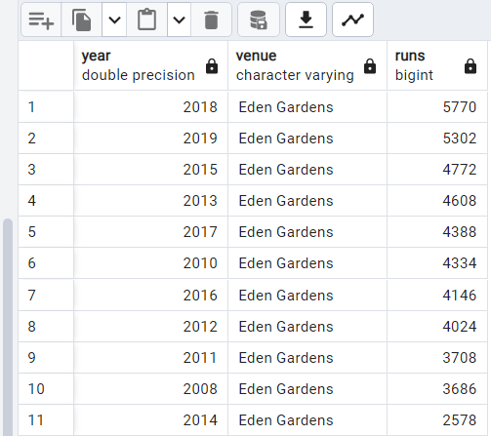
10. Write a query to fetch the year-wise total runs scored at Eden Gardens and order it in the descending order of total runs scored.
select distinct venue from deliveries_v03;
select distinct extract( year from date) as year,venue as venue,sum(total_runs) as runs
from deliveries_v03 where venue = 'Eden Gardens'
group by year,venue
order by runs desc;
OUTPUT

Slide 34
THE END
THANK YOU

